Slide 1
Natural Language Processing
Péter Molnár
pmolnar@rentpath.com/pmolnar@gsu.edu

Slide 2
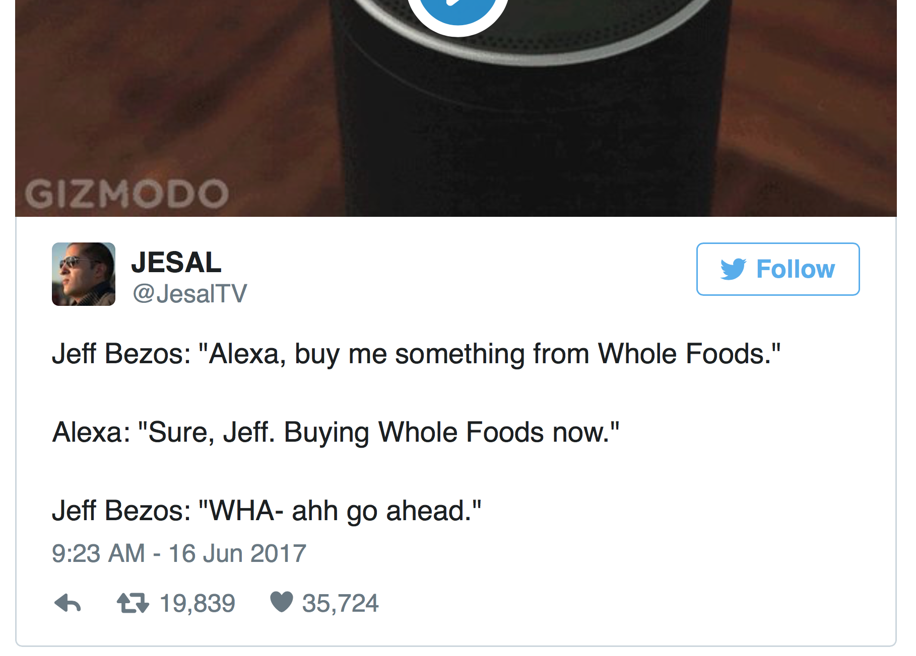

Slide 3
Toolkits
Natural Language Toolkit http://www.nltk.org/
Comprehensive Python programming platform to work with human language data.
Corpora and lexical resources such as WordNet. Text processing libraries for classification, tokenization, stemming, tagging, parsing, and semantic reasoning
Stanford CoreNLP https://stanfordnlp.github.io/CoreNLP/
Statistical parser to produce syntax tree (Java)
Available languages: Arabic, Chinese, English, French, German, and Spanish
OpenNLP http://opennlp.apache.org/
Sentence detector, tokenizer, name finder, document categorizer, part-of-speech tagger, chunker, parser, coreference resolution (Java)
Prolog Natuaral Language Tool (ProNTo) http://ai1.ai.uga.edu/mc/pronto/
Facebook AI Research Sequence-to-Sequence Toolkit https://github.com/facebookresearch/fairseq
Sequence-to-sequence learning toolkit for Torch for Neural Machine Translation (NMT).
Pre-trained models for English to French, English to German and English to Romanian translation.
SyntaxNet: https://github.com/tensorflow/models/tree/master/syntaxnet
TensorFlow toolkit for deep learning powered natural language understanding (NLU).

Slide 4
Books
Dan Jurafsky & James H. Martin, Speech and Language Processing (3rd ed. draft). https://web.stanford.edu/~jurafsky/slp3/
Chris Manning & Hinrich Schütze, Foundations of Statistical Natural Language Processing, MIT Press. Cambridge, MA: May 1999. https://nlp.stanford.edu/fsnlp/ (PDF)
Michael A. Covington, Natural Language Processing for Prolog Programmers, Prentice-Hall, 1994. http://www.covingtoninnovations.com/books.html#nlp
Steven Bird, Ewan Klein, & Edward Loper, Natural Language Processing with Python, O'Reilly, 2009. http://www.nltk.org/book/

Slide 5
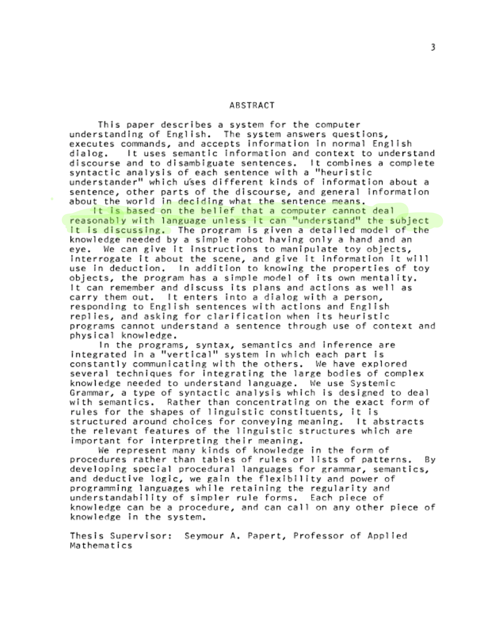
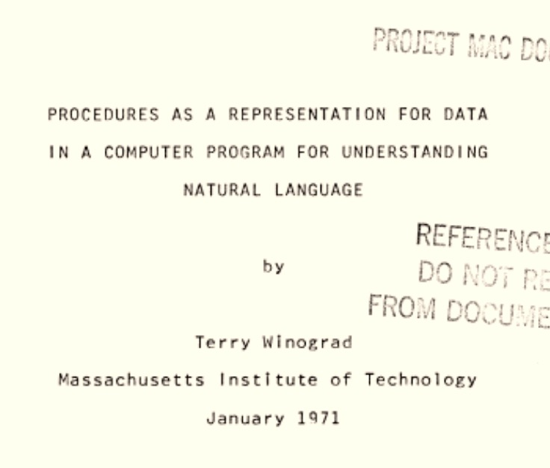
http://hci.stanford.edu/~winograd/shrdlu/

Slide 6
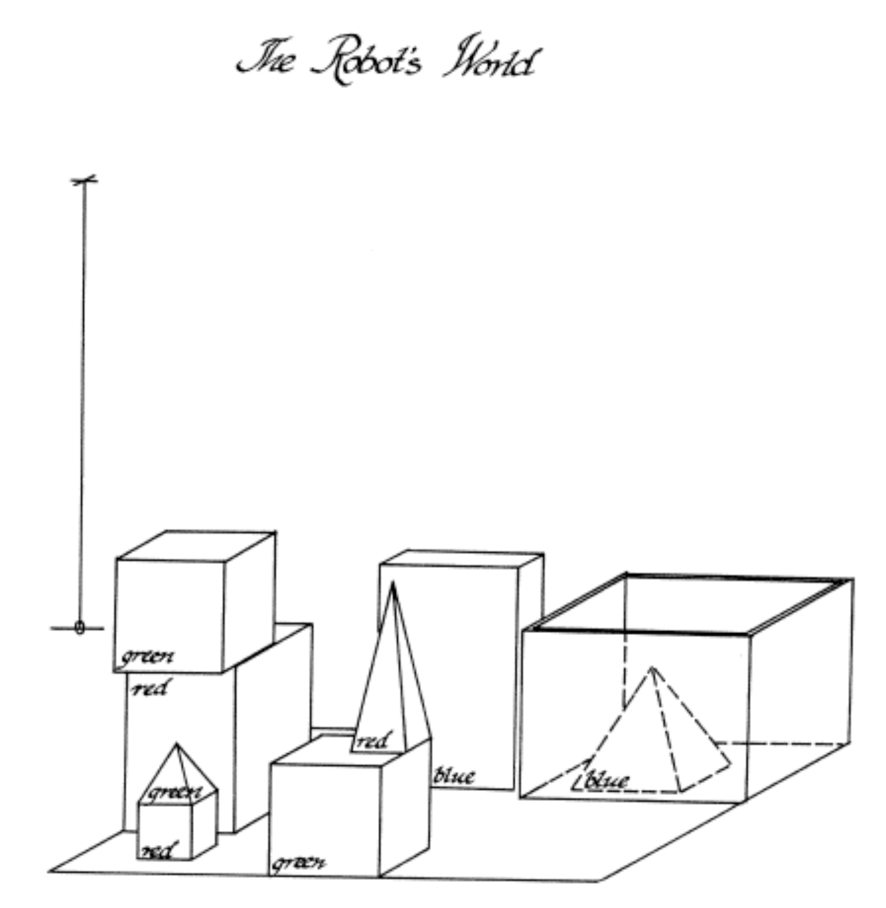
SHRDLU – Blocks World
Person: PICK UP A BIG RED BLOCK.
Computer: OK. (does it)
Person: GRASP THE PYRAMID.
Computer: I DON'T UNDERSTAND WHICH PYRAMID YOU MEAN.
Person: FIND A BLOCK WHICH IS TALLER THAN THE ONE YOU ARE HOLDING AND PUT IT INTO THE BOX.
Computer: BY "IT", I ASSUME YOU MEAN THE BLOCK WHICH IS TALLER THAN THE ONE I AM HOLDING.
Computer: OK. (does it)
Person: WHAT DOES THE BOX CONTAIN?
Computer: THE BLUE PYRAMID AND THE BLUE BLOCK.
Person: WHAT IS THE PYRAMID SUPPORTED BY?
Computer: THE BOX.
Person: HOW MANY BLOCKS ARE NOT IN THE BOX?
Computer: FOUR OF THEM.
Person: IS AT LEAST ONE OF THEM NARROWER THAN THE ONE WHICH I TOLD YOU TO PICK UP?
Computer: YES, THE RED CUBE.
Terry Winograd's dissertation work demonstrated the use of natural language to interact with a robot.
http://hci.stanford.edu/~winograd/shrdlu/

Slide 7
NLP Landscape
no/little syntax
grammatically correct
|Search queries| < |Tweets| < |Messages| < |Blogs| < |News| < |Legal docs|
Vernacular
Symbolic
Part of Speech (POS)
Dictionary
Vector
Sparse
Dense
word2vec embedding
Bag/Set of Words
Topic Modelling (LDA)
Stochastic (Corpus Based)
Term Frequency
Classification
Sentiment Analysis
Grammar
Class
Synset/Thesaurus
Named Entity Recognition
Formal/Technical Language Domain specific vocabulary
Neural Networks
Traditionally curated, now trained with (R)NNs

Slide 8
NLP Pipeline
Lexical Analysis involves identifying and analyzing the structure of words. Lexicon of a language means the collection of words and phrases in a language. Lexical analysis is dividing the whole chunk of text into paragraphs, sentences, and words.
Syntactic Analysis involves analysis of words in the sentence for grammar and arranging words in a manner that shows the relationship among the words. The sentence such as “The school goes to boy” is rejected by English syntactic analyzer.
Semantic Analysis draws the exact meaning or the dictionary meaning from the text. The text is checked for meaningfulness. It is done by mapping syntactic structures and objects in the task domain. The semantic analyzer disregards sentence such as “hot ice-cream”.

Slide 9
NLP Pipeline (2)
Disclosure Integration: The meaning of any sentence depends upon the meaning of the sentence just before it. In addition, it also brings about the meaning of immediately succeeding sentence.
Pragmatic Analysis: During this, what was said is re-interpreted on what it actually meant. It involves deriving those aspects of language which require real world knowledge.
Source: https://www.tutorialspoint.com/artificial_intelligence/artificial_intelligence_natural_language_processing.htm

Slide 10
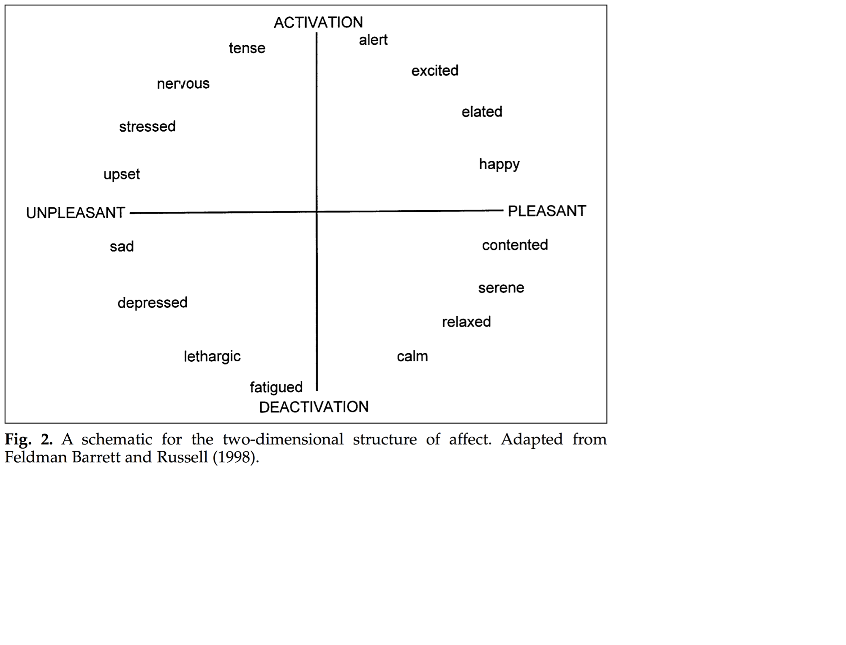
Sentiment Analysis
Classifying the polarity of a given text at the document, sentence, or feature/aspect level—whether the expressed opinion in a document, a sentence or an entity feature/aspect is positive, negative, or neutral.
Advanced, "beyond polarity" sentiment classification looks, for instance, at emotional states such as "angry", "sad", and "happy".
Dataset https://github.com/jperla/sentiment-data

Slide 11
Challenges in Sentiment Analysis
Simple cases → determine polarity based on trigger words might be sufficient
Coronet has the best lines of all day cruisers.
Bertram has a deep V hull and runs easily through seas.
Pastel-colored 1980s day cruisers from Florida are ugly.
I dislike old cabin cruisers.
More challenging examples → trigger words alone would fail, require syntax analysis
I do not dislike cabin cruisers. (Negation handling)
Disliking watercraft is not really my thing. (Negation, inverted word order)
Sometimes I really hate RIBs. (Adverbial modifies the sentiment)
I'd really truly love going out in this weather! (Possibly sarcastic)
Chris Craft is better looking than Limestone. (Two brand names, identifying target of attitude is difficult).
Chris Craft is better looking than Limestone, but Limestone projects seaworthiness and reliability. (Two attitudes, two brand names).
The movie is surprising with plenty of unsettling plot twists. (Negative term used in positive sense).
I love my mobile but would not recommend it to any of my colleagues. (Qualified positive sentiment, difficult to categorize)

Slide 12
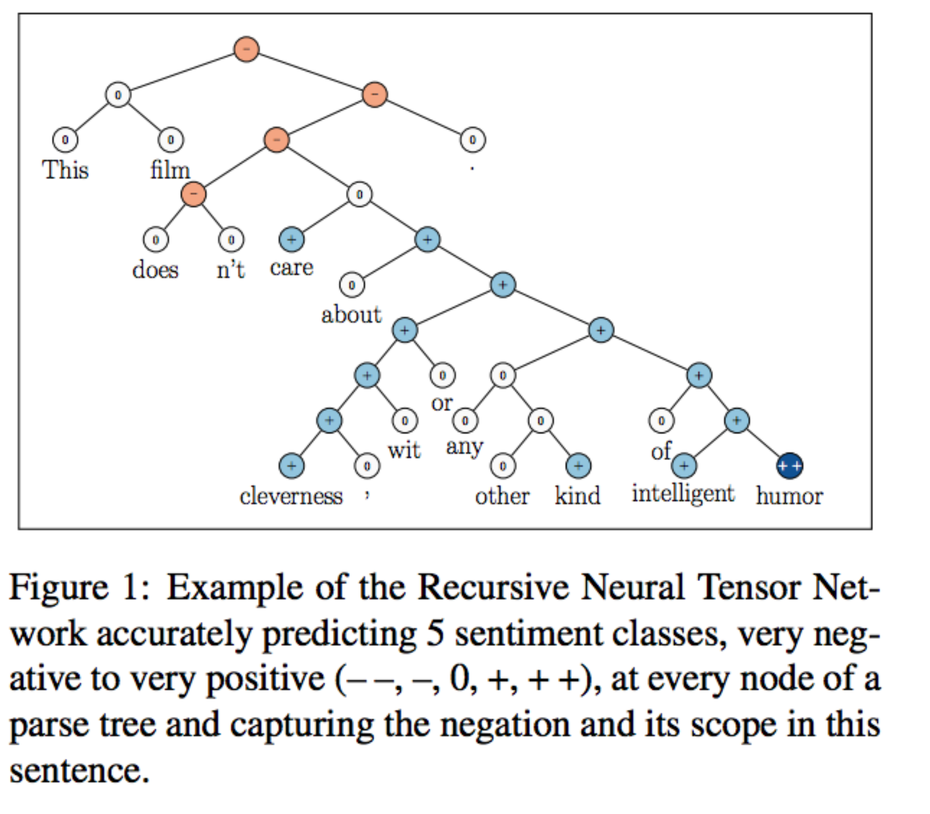
Sentiment Treebank
Challenge to express the meaning of longer phrases in a principled way.
Accurately capture the effects of negation and its scope at various tree levels for both positive and negative phrases
Based on Stanford Sentiment Treebank
Ref: Richard Socher, Alex Perelygin, Jean Wu, Jason Chuang, Christopher Manning, Andrew Ng, and Christopher Potts. 2013. Recursive Deep Models for Semantic Compositionality Over a Sentiment Treebank.
https://nlp.stanford.edu/~socherr/EMNLP2013_RNTN.pdf

Slide 13
Formal Languages/Grammars
A formal grammar consists of a finite set of production rules (left-hand side → right-hand side), where each side consists of a finite sequence of the following symbols:
a finite set of nonterminal symbols (indicating that some production rule can yet be applied)
a finite set of terminal symbols (indicating that no production rule can be applied)
a start symbol (a distinguished nonterminal symbol)
Nonterminals are often represented by uppercase letters, terminals by lowercase letters, and the start symbol by S.
For example, the grammar with terminals {a, b}, nonterminals {S, A, B}, production rules
S → AB
S → ε (where ε is the empty string)
A → aS
B → b
and start symbol S, defines the language of all words of the form:
ab
aabb
aaabbb
…
Chomsky, Noam (1956). "Three models for the description of language" . IRE Transactions on Information Theory (2): 113–124. doi:10.1109/TIT.1956.1056813

Slide 14
(Toy) example of English language
Terminals {generate, hate, great, green, ideas, linguists}
Nonterminals {SENTENCE, NOUNPHRASE, VERBPHRASE, NOUN, VERB, ADJ}
Production Rules SENTENCE → NOUNPHRASE VERBPHRASE NOUNPHRASE → ADJ NOUNPHRASE NOUNPHRASE → NOUN VERBPHRASE → VERB NOUNPHRASE VERBPHRASE → VERB NOUN → ideas ADJ → great NOUN → linguists ADJ → green VERB → generate VERB → hate
Start Symbol SENTENCE .
green ideas generate great linguists

Slide 15
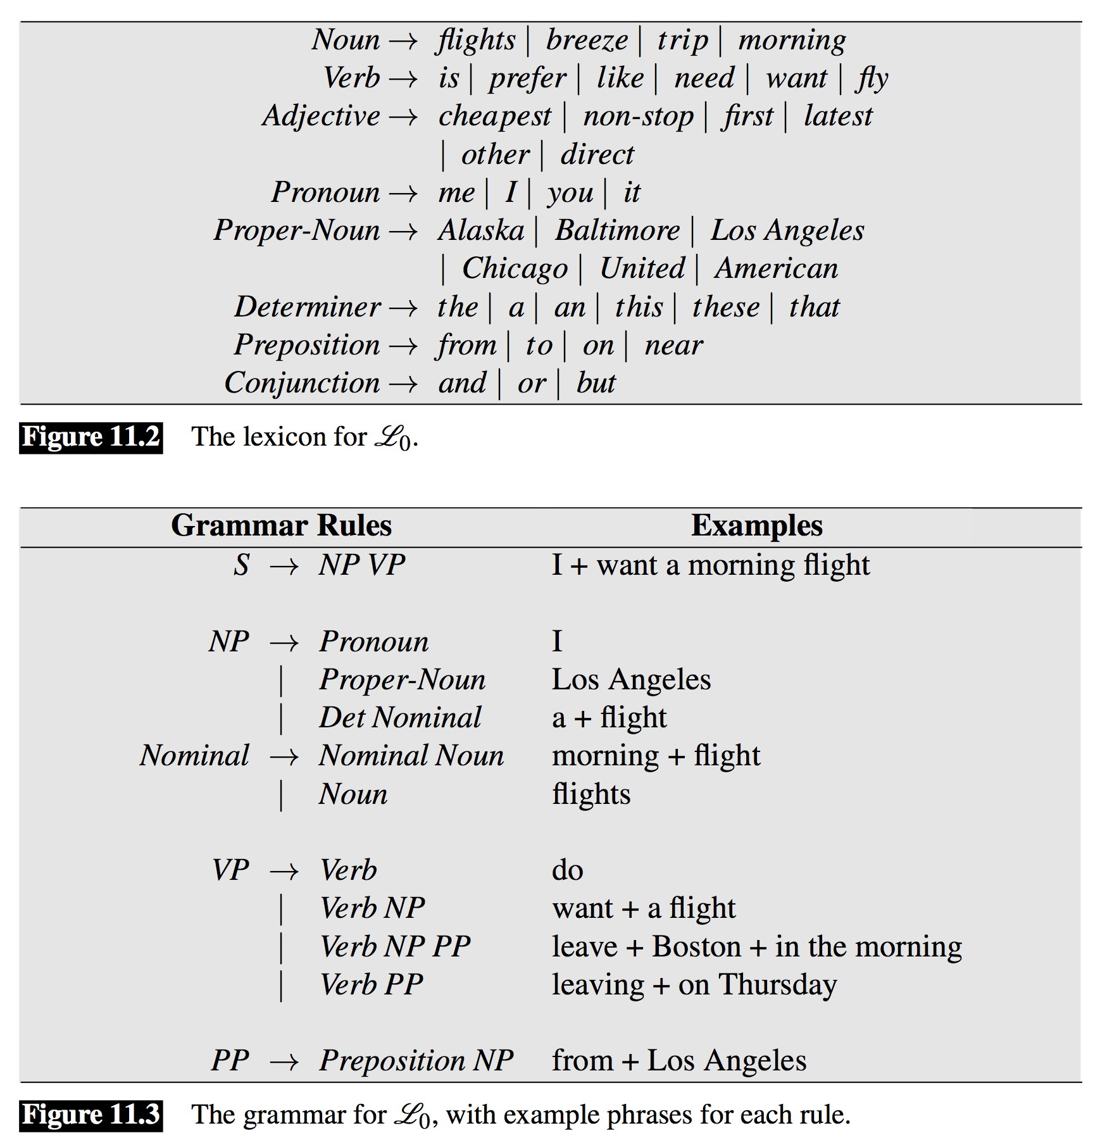
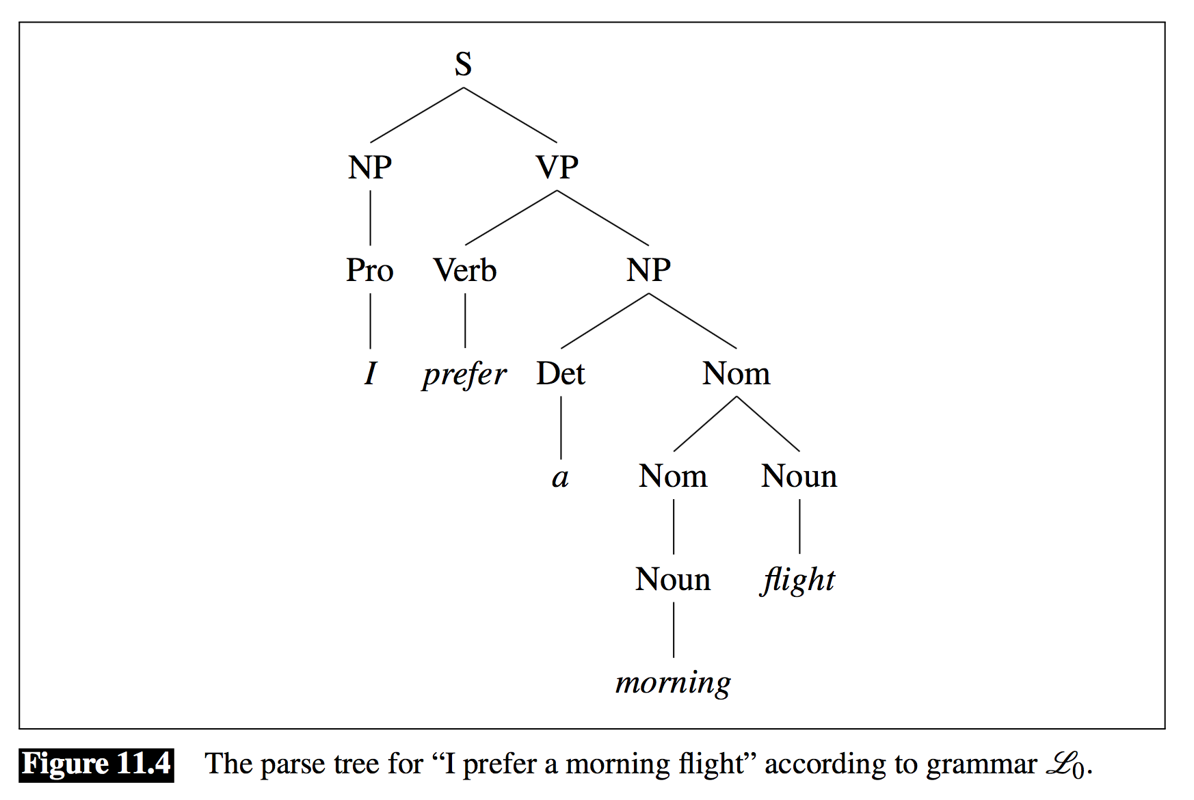
Example Grammar
https://web.stanford.edu/~jurafsky/slp3/11.pdf

Slide 16
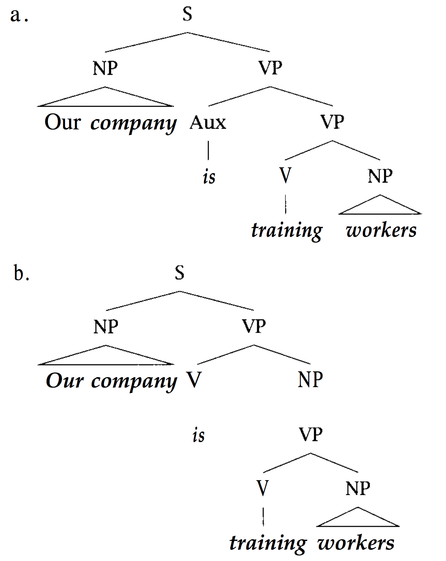
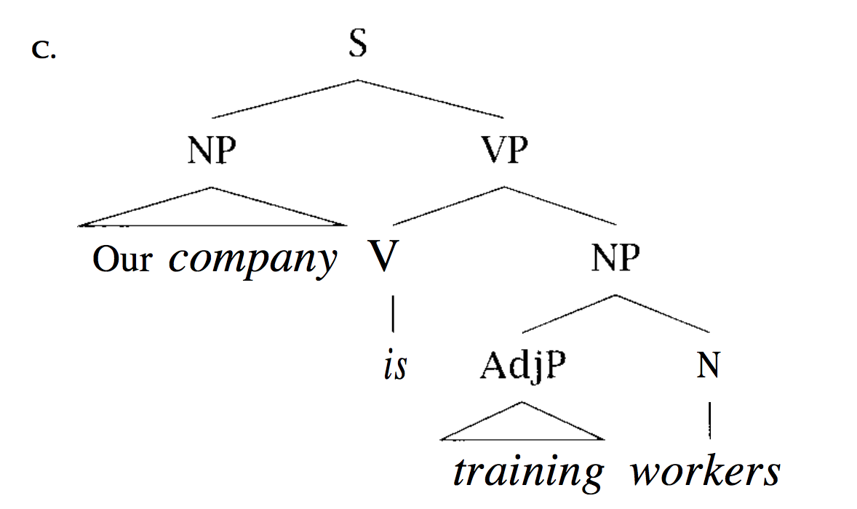
Ambiguity of Language

Slide 17
Chomsky's four types of grammars
Grammar | Languages | Automaton | Production rules (constraints)
Type-0 | Recursively enumerable | Turing machine | α→β (no restrictions)
Type-1 | Context-sensitive | Linear-bounded non-deterministic Turing machine | αAβ→αγβ
Type-2 | Context-free | Non-deterministic pushdown automaton | A→γ
Type-3 | Regular | Finite state automaton | A→a and A→aB

Slide 18
Demos
Introduce Prolog: kinship.pl
Simple grammar for writing out numbers: numbers.pl
Simple English grammar with concept representation: naturallanguage.pl
Free-word dependency parser (Latin): dparse.pl
Presentation and examples are posted at https://github.com/kingmolnar/natural_language

